Slide 1
GluonCV: Image Classification
Tong He
Applied Scientist, Amazon Web Services.
2018.12.17

Slide 2
Introduction

Slide 3
What is classification?
Tell you what is in the image

Slide 4
Applications
Digit Recognition
Car Model Detection
Facial Recognition

Slide 5
Image Classification with Deep Learning

Slide 6
Classification with Deep Learning
MNIST: The “Hello World” dataset
28 x 28 input
Grayscale
50000 training
10000 test

Slide 7
Classification with Deep Learning
Fully-connected Layer
Expensive
2D insensitive

Slide 8

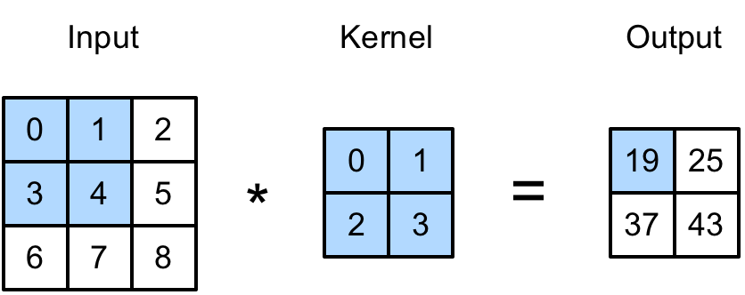
Classification with Deep Learning
Convolution Layer
0*0 + 1*1 + 3*2 + 4*3 = 19

Slide 9
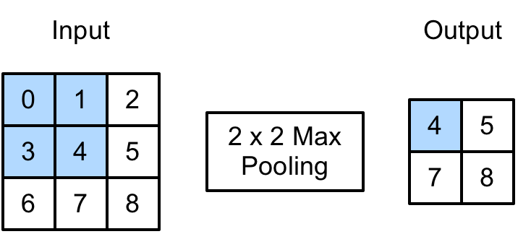
Classification with Deep Learning
Pooling Layer
Demonstration Video

Slide 10
Classification with Deep Learning
Activation Layer

Slide 11
Classification with Deep Learning
LeNet
Demonstration WebSite

Slide 12
Classification with Deep Learning
ImageNet Challenge
Natural images
1000 classes
1.2 million images

Slide 13
Classification with Deep Learning
Difficulties
LeNet is too small
Hard to process huge amount of data

Slide 14
Classification with Deep Learning
AlexNet
GPU Accelerated
Deep (8 layers)

Slide 15
Classification with Deep Learning
VGG
Deeper
Better architecture

Slide 16
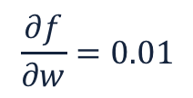
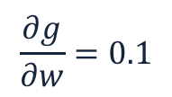
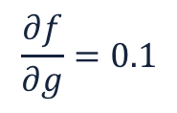
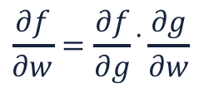
Classification with Deep Learning
Can we go deeper?
Vanishing/Exploding Gradient
Chain rule:
$$\frac{∂f}{∂w}=\frac{∂f}{∂g} ̇\frac{∂g}{∂w}$$
$$\frac{∂f}{∂g}=0.1$$
$$\frac{∂f}{∂w}=0.01$$
$$\frac{∂g}{∂w}=0.1$$

Slide 17
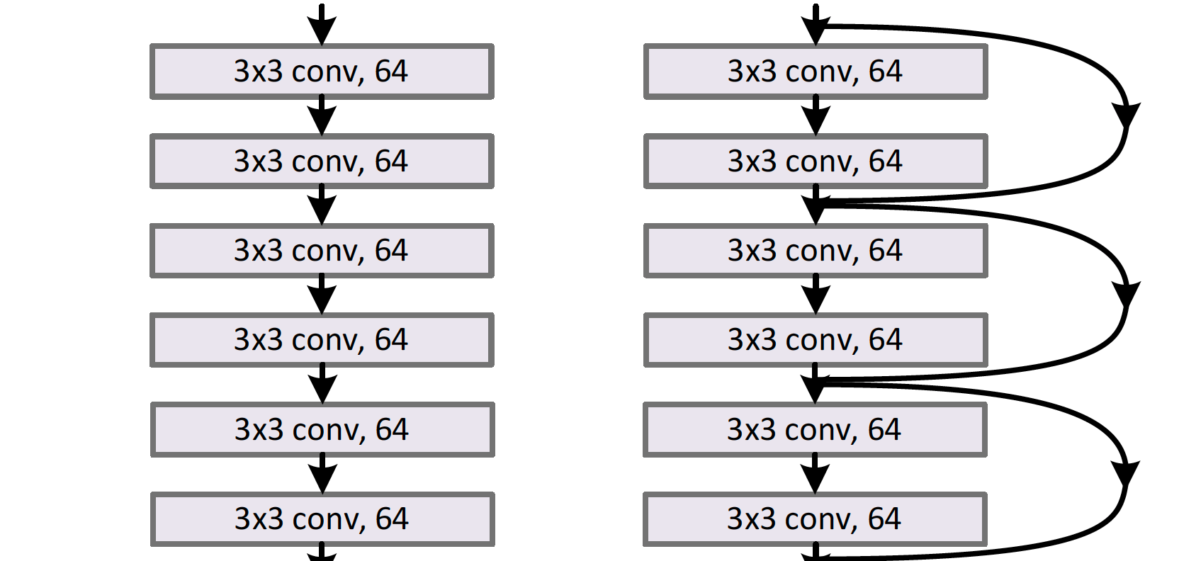
Classification with Deep Learning
ResNet
Residual
152 layers!
Modularized
Plain network
Network with residual

Slide 18
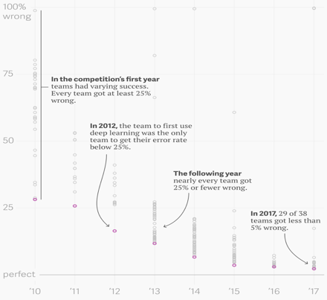
Classification with Deep Learning
ImageNet Results
Top-5 error: 25% to 5%
Hundreds of new models

Slide 19
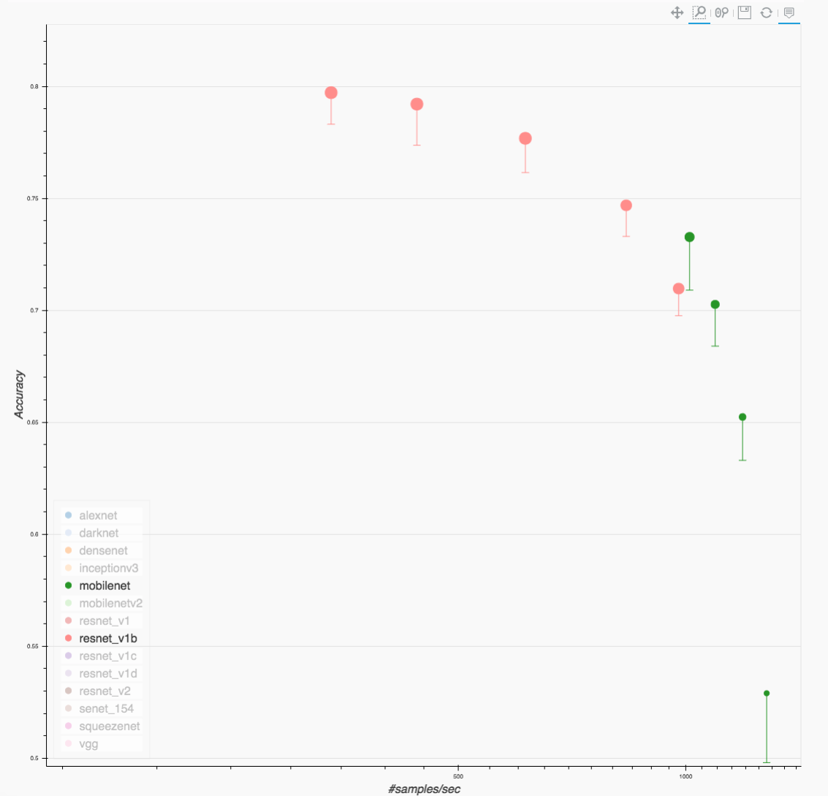
Classification with Deep Learning
MobileNet
Depth-wise Convolution
Parameterized Size
Fast Inference on devices

Slide 20
Classification with Deep Learning
NASNet
Automatic Search
Accurate and heavy

Slide 21
Model Summary
ResNet:
Balanced accuracy and speed
Well modularized
MobileNet:
Small size
Fast inference
NAS:
Ongoing research topic

Slide 22
Classification with GluonCV

Slide 23
Classification with GluonCV
Model Zoo
Pre-trained models
Can be transferred or directly applied

Slide 24
Classification with GluonCV
GluonCV Model Zoo
Comprehensive selection
AlexNet
VGG
ResNet
MobileNet
NASNet
…
One of the most accurate open-sourced libraries
Reproducible

Slide 25
Classification with GluonCV
Training Essentials
Data Preprocessing
Network architecture definition
Optimizer
Loss
Metric
GPU Acceleration

Slide 26
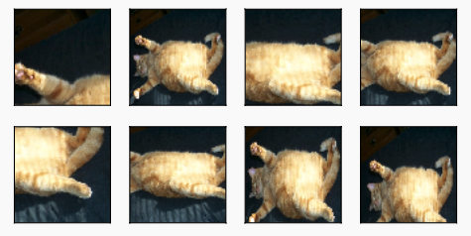
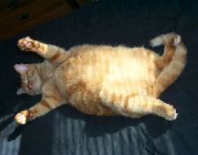
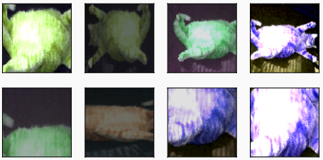
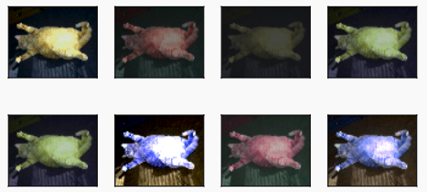
Classification with GluonCV
Data Preprocessing

Slide 27
Classification with GluonCV
Optimizers
SGD
Adam
RMSProp
…

Slide 28
Classification with GluonCV
Advanced Tricks
Label smoothing
Learning rate schedule
Mix-Up
Knowledge Distillation

Slide 29
Classification with GluonCV
Label Smoothing
One hot: (0, 1, 0, 0, 0)
Smoothed: (0.01, 0.96, 0.01, 0.01, 0.01)
Prevent overfitting!

Slide 30
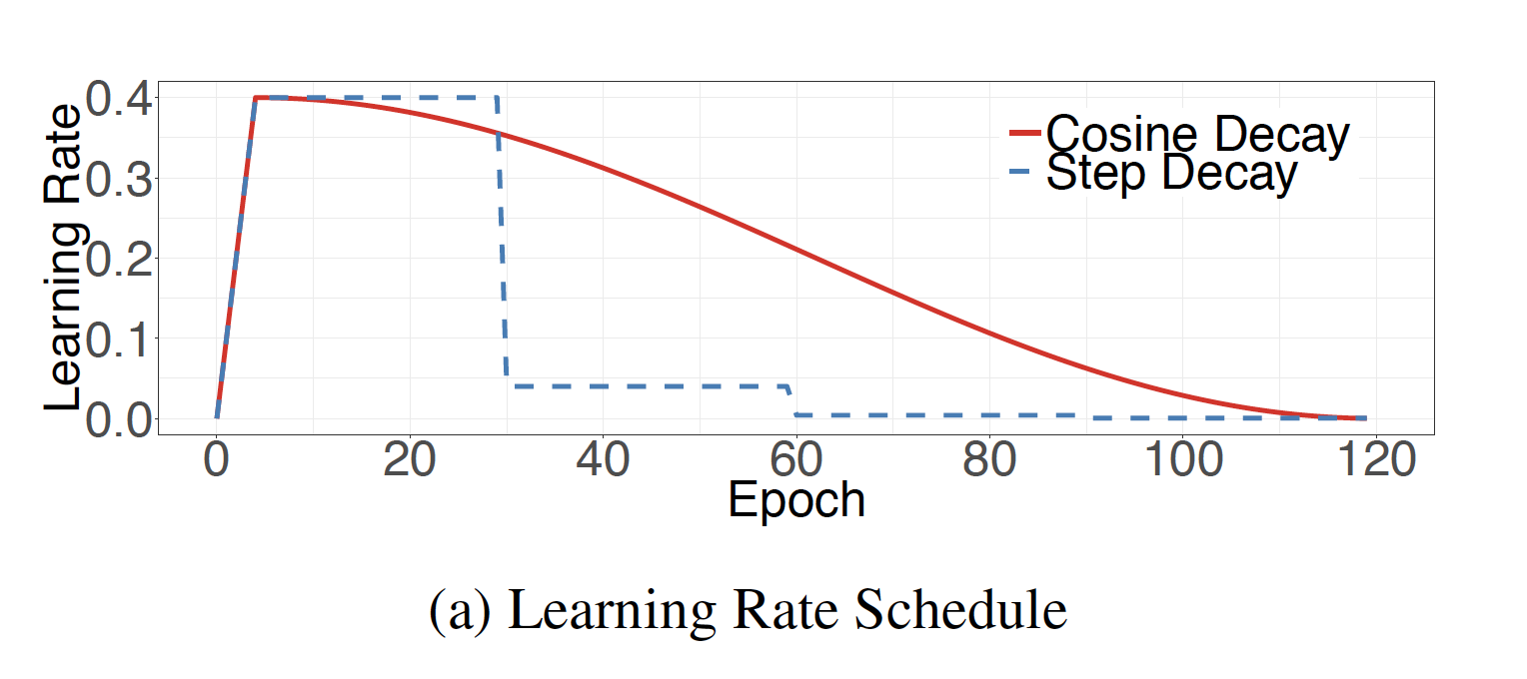
Classification with GluonCV
Learning Rate Schedule
Step
Cosine
Poly

Slide 31


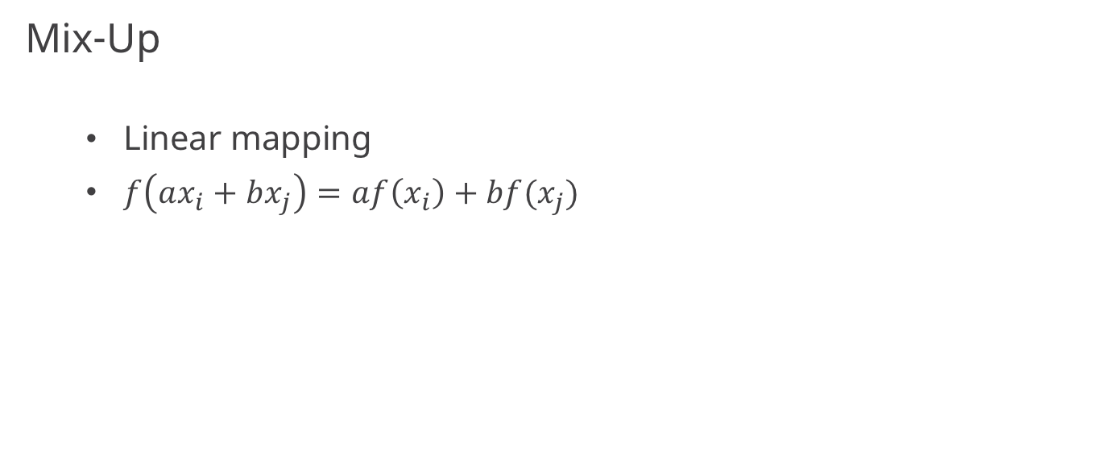
Classification with GluonCV
Mix-Up
Linear mapping
$f\left(ax_{i}+bx_{j}\right)=af\left(x_{i}\right)+bf(x_{j})$

Slide 32
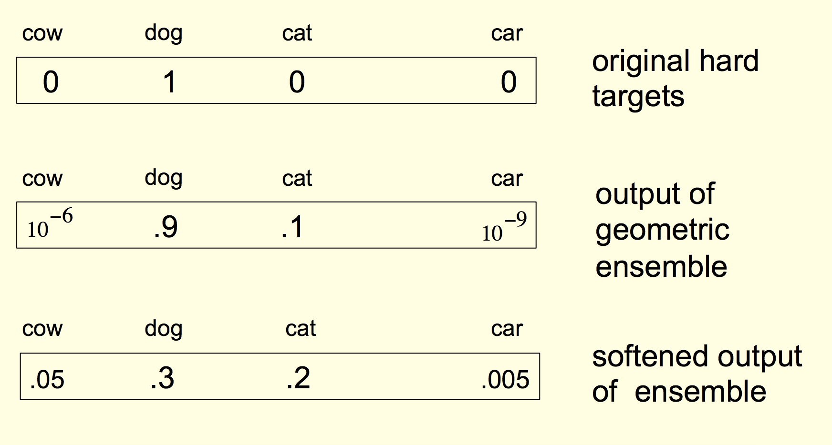
Classification with GluonCV
Knowledge Distillation
Dark Knowledge
Dog vs Cat
Dog vs Car

Slide 33
Classification with GluonCV
Knowledge Distillation

Slide 34
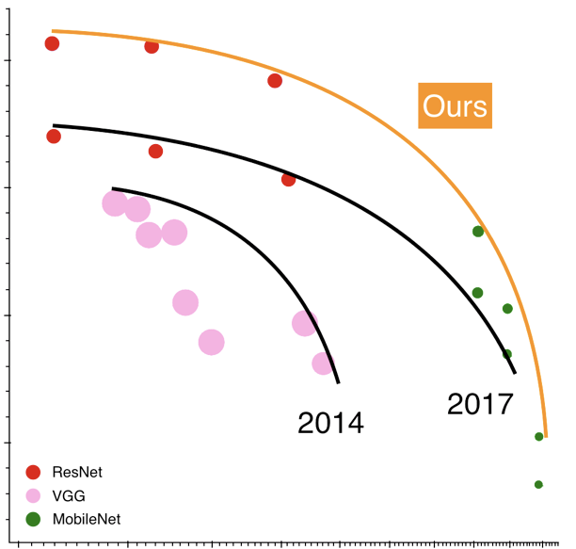
Classification with GluonCV
GluonCV Model Zoo
He, Tong, et al. "Bag of Tricks for Image Classification with Convolutional Neural Networks" arXiv preprint arXiv:1812.01187 (2018).

Slide 35
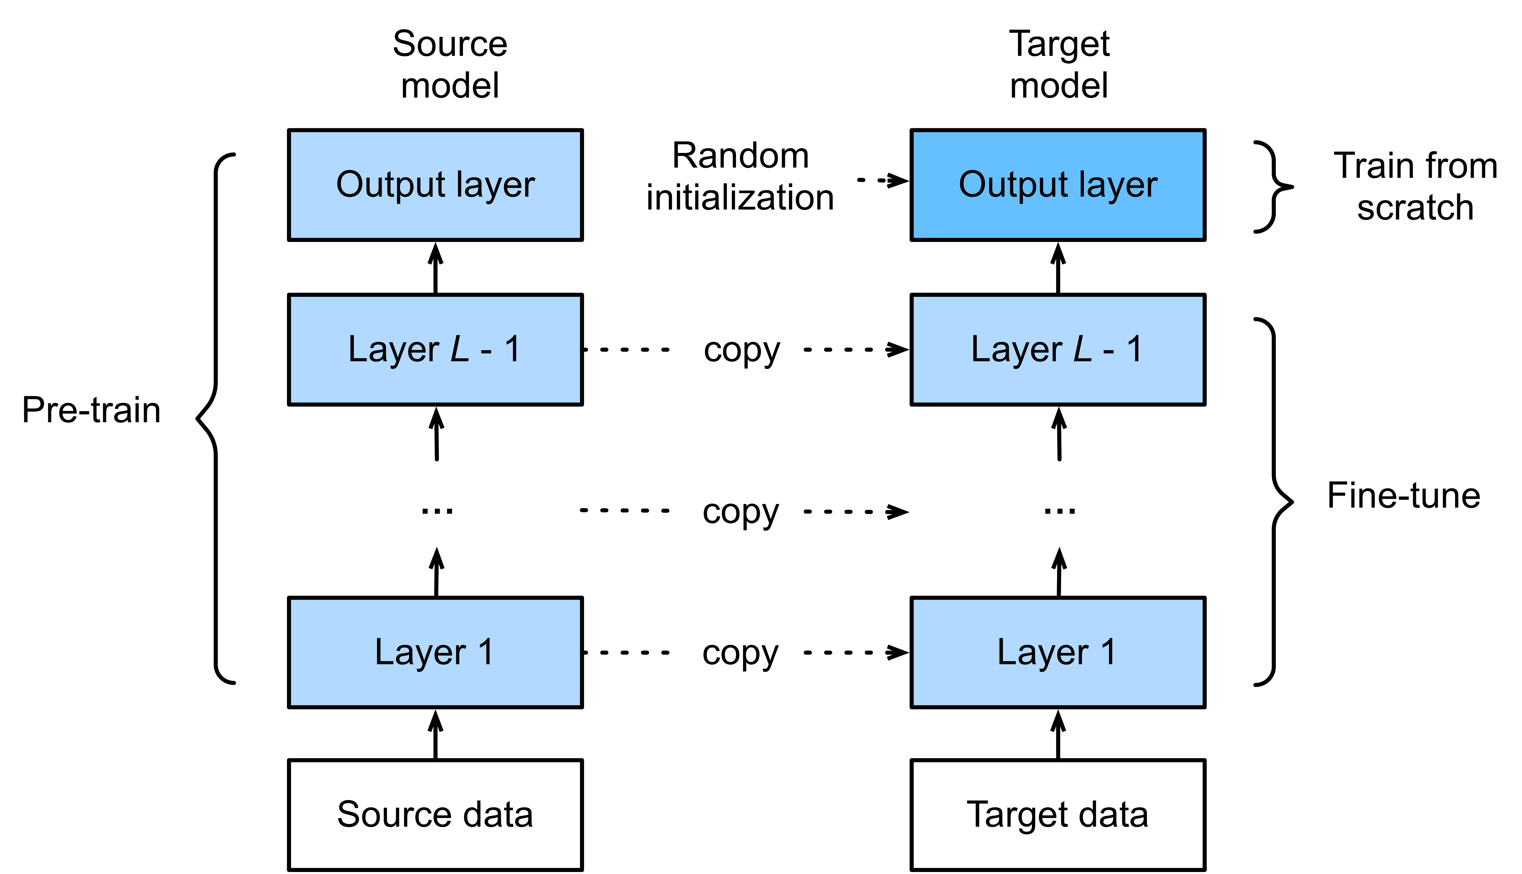
Classification with GluonCV
Transfer learning
Based on a pre-trained model
Re-define the output layer
Base
New

Slide 36
Classification with GluonCV
Resources:
Model Zoo: https://gluon-cv.mxnet.io/model_zoo/classification.html
Tutorials: https://gluon-cv.mxnet.io/build/examples_classification/index.html
Deep Learning Book: http://diveintodeeplearning.org/

Slide 37
Classification with GluonCV
Hands on!

